Slide 1
PSYCHOLOGICAL DISORDER PROFILING { DATA EXTRACTION }
< RECENT TRENDS IN SOFTWARE ENGINEERING >
BY
ANIRUDH BHATTACHARYA
PRANAV NIMBALKAR

Slide 2
CONTENTS
TWITTER API – SETTING CREDENTIALS
TWEEPY – STREAMING TWITTER LIB
TWITTER API – STREAMING VIA PYTHON
STREAMING OUTPUT – JSON DATA
TAGS – PLUGINS (GOOGLE SPREADSHEET)
TAGS OUPUT – EXCEL FORMAT DATA
Q & A

Slide 3
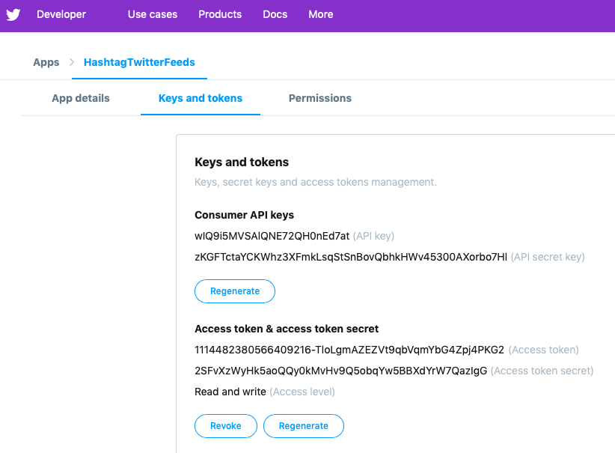
TWITTER API – SETTING CREDENTIALS

Slide 4
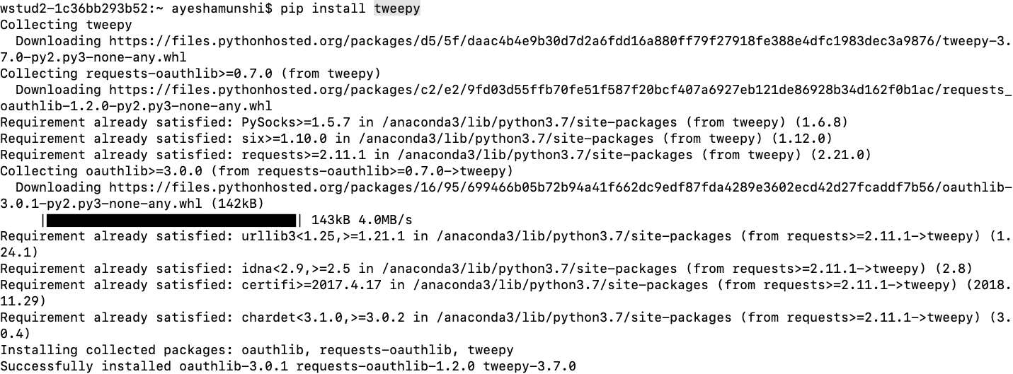
TWEEPY – STREAMING TWITTER LIB

Slide 5
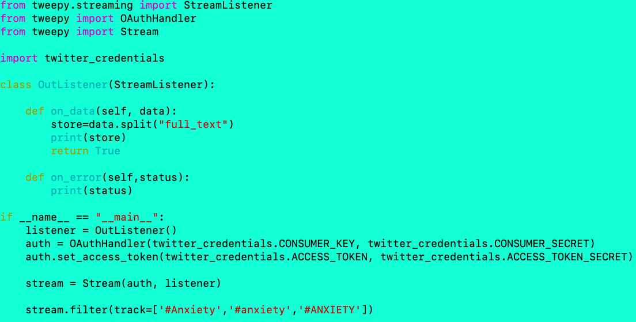
TWITTER API – STREAMING VIA PYTHON

Slide 6
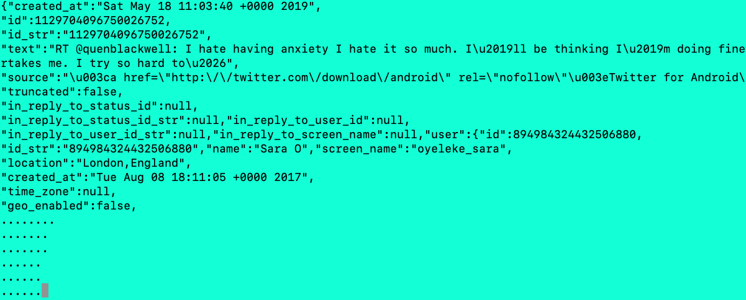
STREAMING OUTPUT – JSON DATA

Slide 7

TAGS – PLUGINS (GOOGLE SPREADSHEET)
ANALYTIC PAKAGE PLUGINS
Image Source: https://nocodewebscraping.com/wp-content/uploads/2016/09/how-to-extract-twitter-data-to-excel.png

Slide 8
TAGS – PLUGINS (GOOGLE SPREADSHEET)

Slide 9
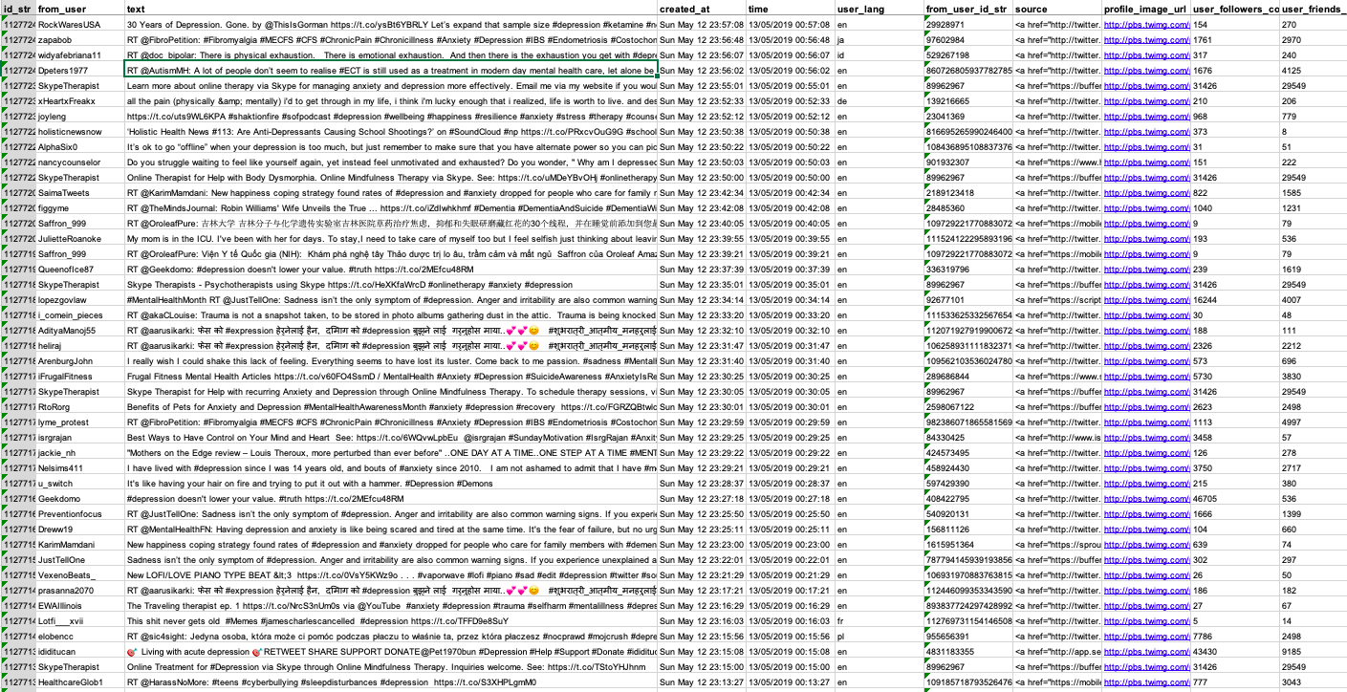
TAGS OUPUT – EXCEL FORMAT DATA

Slide 10
Q & A

Slide 11
THANK YOU

